Slide 1
Weekly Review

Slide 2
Duolingo
Fewer people are doing this and their goals are getting larger

Slide 3
Easy Week
CIW is over. We will continue to review to keep it fresh.
I got really confused about which week it was supposed to end
We will be taking the exams AFTER Noct
We will print out the Certification of Completion this week
Juniors, work hard on your personal projects
Everyone must have something substantial to justify the amount of time I’ve given them in class these past few weeks.
You have an assignment to create questions about your project for me. We will go over these together Wednesday
Seniors, do a good job on your projects this week.

Slide 4
Upcoming
We will grind the Nocti for two weeks until we take it
After, we will work on Professionalism and Employability skills
We will likely charter companies again this year, and Seniors will have to hire Juniors
We will also get our CIW Javascript Specialist Certification
We may try to squeeze in IT Fundamentals as well
Having trouble securing funds for the training material

Slide 5
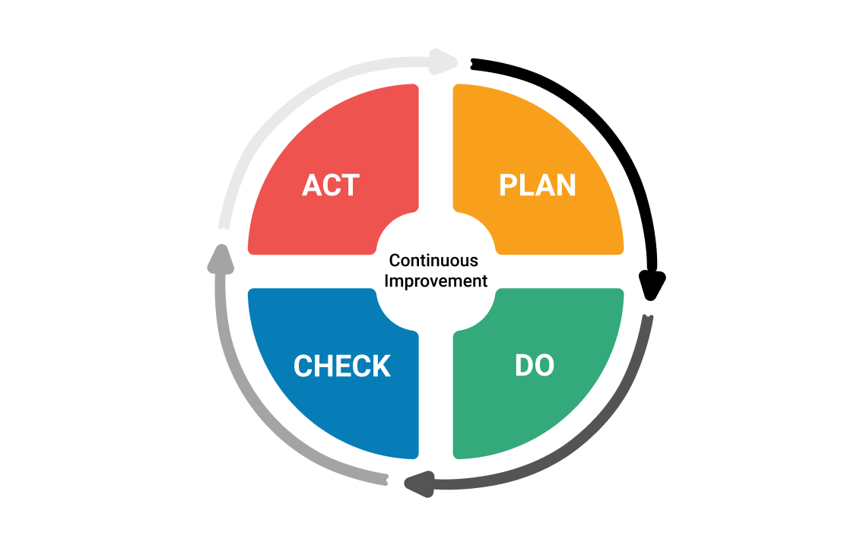
Continuous Improvement

